Slide 1

CU MARKETPLACE: WAVE 2 OVERVIEW

Slide 2
Agenda
Introductions
Project Overview
Wave 2 - What’s New
Roles / Access / Workflow
CU Marketplace Demonstration
Training and Guidance
Preparation and Transition Activities
Questions
Notes:
Kate

Slide 3
Introductions
Today’s presenters
Hugh Horowitz, Assistant Vice President, Procurement Services
Geoff Mielke, Associate Director, Strategic Sourcing
Ron Moraski, Vice President, Procurement Services
Terry Park, Executive Director, Finance Information Systems
Kate Sheeran, Assistant Vice President, Finance Administration
Eric Zaretsky, Director, Finance Training
Notes:
Kate

Slide 4
Audience and Q&A
Information presented in this overview is relevant for anyone who needs to buy and/or pay for goods and services for University business, including:
  Requisition Initiators
  Requisition Approvers
  Voucher Initiators
  Voucher Approvers
If you have questions as we go through the presentation, please use the Q&A function to submit your question(s) and we will address both during and at the end of the presentation.
Notes:
Kate

Slide 5
Overview Objectives
Provide a high-level refresher of the Procure-to-Pay project.
Introduce what’s new in the CU Marketplace with this wave of the project.
Today is an overview, not training. Depending on your current role(s), web-based training has already been assigned to you (and hopefully you’ve already completed it!).
Guides and job aid materials are available on the Buying and Paying Training page of the new Finance Training site: https://training.finance.columbia.edu/content/cu-marketplace-training.
Information sessions are recorded and posted on the Shopping in the CU Marketplace page of the new Procurement site: https://procurement.finance.columbia.edu/content/shopping-cu-marketplace
Notes:
Kate

Slide 6
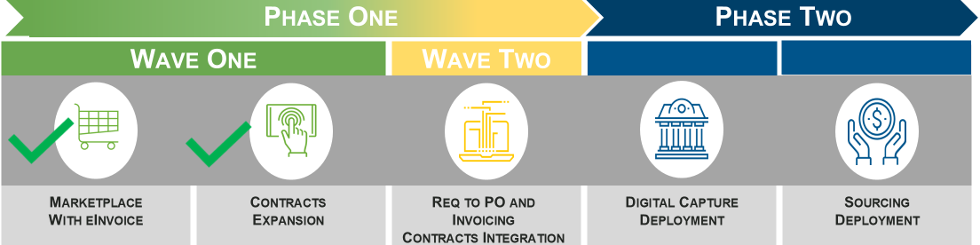
Project Overview
The P2P project will be delivered in multiple phases.
Wave 1 - November 2023: launched University-wide
  Introduction of the CU Marketplace with negotiated Catalog pricing for 20+ suppliers (now 30), which included eInvoicing
Wave 2 - March 2025: Pilot launched
  Non-Catalog (Requisition to PO) buying for both goods and services
  Associated voucher processing
  Contract Request to create visibility in the contracting process from campus to Central Purchasing
Wave 2 - July 2025: Phase 1, Wave 2 launched University-wide
Future Phases: Digital Capture for Invoices; Sourcing / RFP Tool
Notes:
Ron

Slide 7
Wave 2: What’s New
Updated Marketplace user experience
  Welcome page with Action Items and navigation tiles that link to task-oriented dashboards
  Use of Adopt functionality (information icon) to provide guided assistance
Guided buying experience for Non-Catalog purchases
  For both goods and services
  Form with conditional logic to capture required data
Voucher processing
  For both PO and non-PO invoice processing
Notes:
Ron

Slide 8

Wave 2: What’s New (continued…)
Contract Request
  *is NOT a Contract, it’s the vehicle to request a Contract
Contract Request is the step prior to putting a Contract in place
  Replaces email back and forth
  Created when a Contract is needed as part of the purchase or engagement
  Form that requests information to assist the Central Purchasing team in assessing requirement(s) for putting a Contract in place
  Allows for transparency and workload balancing in Central Purchasing
Notes:
Ron

Slide 9
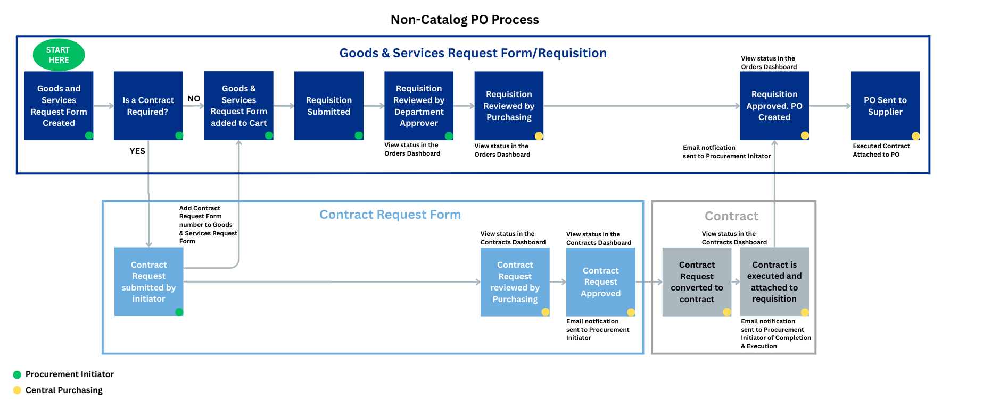
Requisition to PO & Contract Request Process
Notes:
Hugh / Geoff

Slide 10
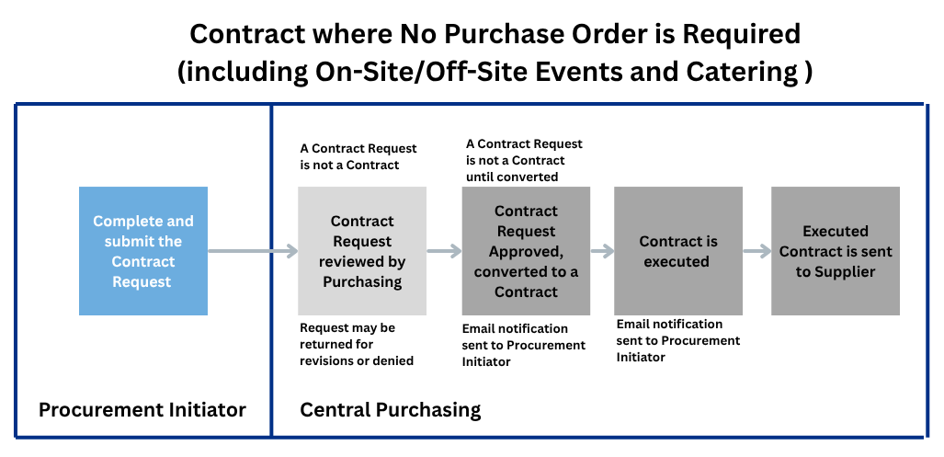
Contract Request Process
Contract Where No Purchase Order is Required
Notes:
Hugh / Geoff

Slide 11
Wave 2 Pilot
As with any project of this scale, always good to run a pilot with a smaller group before rolling out to the wider University. This allowed us to:
  Identify and address any technical issues
  Refine and enhance training and guidance materials based on feedback
Grateful to our pilot participants, who were identified to participate in the pilot due to their diverse Procurement use cases (subset of users from each of the following Schools / Departments):
  Arts & Sciences
  Climate School / Lamont
  CUIMC (Central, Dental, MSPH, VP&S)
  Engineering
  Investment Management Company
  Professional Studies
  Zuckerman
Notes:
Kate

Slide 12
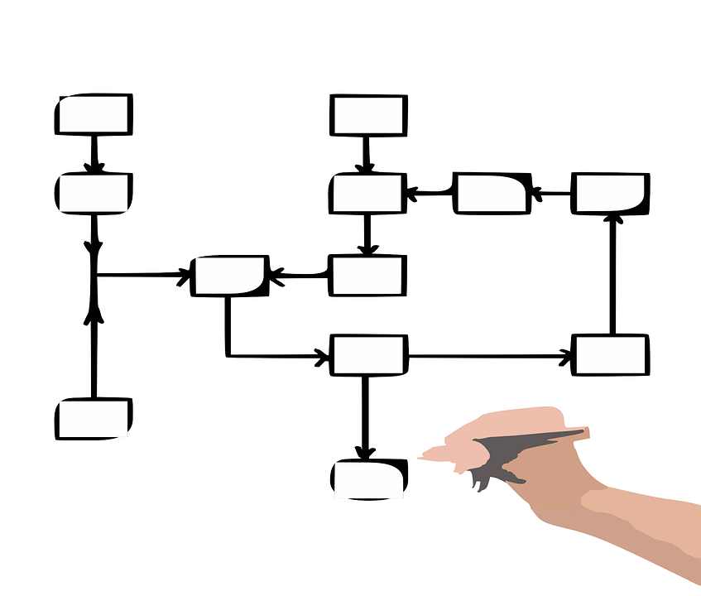
CU Marketplace Roles, Access, and Workflow
Notes:
Terry

Slide 13
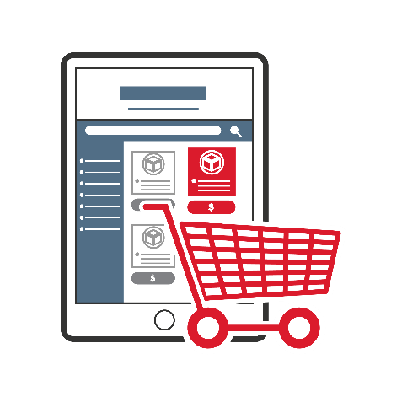


CU Marketplace Roles: Who Can Do What
Role |  | Description
 | Shopper | Shop from catalog suppliers and create carts Assign carts to Initiators
 |  | Shop and create carts from catalog suppliers Receive carts from Shoppers Shop and create requisitions from non-catalog suppliers Create vouchers for non-catalog invoices
 | Department Approver Special Approver Ad Hoc Approver | Receive requisitions submitted for approval via workflow Receive vouchers submitted for approval via workflow Review all requisitions submitted for their specific approval
Procurement Initiator (new - Requisition Initiator & Voucher Initiator roles combined)
Notes:
Terry

Slide 14
CU Marketplace Shopper vs Initiator
Shopper
Add items from Catalog Suppliers into a cart
Assign their cart to a Procurement Initiator to submit into workflow
Can complete information (such as ChartString) on the requisition
No required training
Cannot purchase Non-Catalog Goods and Services
Procurement Initiator
Combined Requisition Initiator and Voucher Initiator roles
Can create and submit Catalog and Non-Catalog requisitions into workflow
Can submit Vouchers into workflow
Can submit Contract Requests
Must complete required training to get access to the CU Marketplace
14
Notes:
Terry

Slide 15
Workflow-Requisitions, Change Requests and Vouchers
Submit
Transaction
Department
Approval
Special
Approval
Central Procurement
Approval
PO Dispatch/ Paycycle
Approval Workflow Stage | Approval Workflow Trigger | Approval Workflow Role (Existing ARC Roles)
Department | Financial Approval based on combination of Department and Dollar Threshold Pooled Approver routing Dollar Thresholds aligned with ARC | Department Requisition Approver Departmental Voucher Approver
Special (if applicable) | Combination of Category Code and Dollar Threshold (e.g. Capital Equipment, Hazardous Materials, etc.) | Prior Approver
Procurement (Central Purchasing or Central AP) | Requisitions and Change Requests Catalog > $50K All Non-Catalog Orders Non PO Vouchers All Non-Catalog Orders | Purchasing Accounts Payable
Ad Hoc - Inserted manually by an Initiator or Approver into workflow when additional review is necessary
Notes:
Terry

Slide 16
Other Points to Remember: Receiving & RITA
Receiving
For Catalog orders, Receiving is required when:
  Line amount (not total order) is equal to or greater than $5,000.
For Non-Catalog orders, receiving is not required.
  Processing of the invoice for payment is acknowledgement that the goods or services were received.
  Leverage existing controls in place for goods that fall into a special handling category and/or capital equipment.
RITA (Requester-Initiated Transaction Approval)
When users have both the Requisition Initiator (Procurement Initiator role as of 7/1/25), and the Requisition Approver roles with Level 1 dollar threshold approval, they can request and approve the same transaction.
Only applies to CU Marketplace orders up to $1,000 from Catalog suppliers and when the purchase is shipped to a campus location. All Non-Catalog purchases, regardless of dollar amount, will require approval by someone (with the Approver role) separate from the Initiator.
16
Notes:
Terry

Slide 17
PO Conversion
ARC PO Conversion to the Marketplace
  ~4,000 POs converted (including multi-year POs)
    Converted POs can be used for outstanding invoices
    No Change Requests can made to a converted PO
    All converted POs will be closed as part of FY26 Year End Close
SAPO Conversion
  ~1,500 SAPOs converted
  Currently not visible to dept users due to Document Access issue
    Targeting fix for July 10, 2025
Notes:
Terry

Slide 18
CU Marketplace vs. ARC
As of July 1st, 2025…
Transaction | CU Marketplace | ARC
Requisitions / POs | x
Contract Request | x
Payments (Vouchers) | x
Petty Cash Replenishment | x
Journal Vouchers |  | x
P-Card Reconciliation & Approval |  | x
SAPOs (SPA only) |  | x
SAPO Invoices | x
18
Notes:
Terry

Slide 19
Demonstration
Accessing the CU Marketplace:
  Log into ARC using Single Sign-On, click on the Buying and Paying tile and then select the CU Marketplace tile or
  From multiple locations across the new Procurement site:
    From the Buying and Paying menu dropdowns, look for the Systems Access header and then select Log Into the CU Marketplace.
    From the homepage, click on the Log Into the CU Marketplace icon under Log Into Procurement Systems.
    A hyperlink titled Go to the CU Marketplace is permanently located in the top right of the new Procurement site’s header next to links to About Us and Forms & Documents.
    From a variety of topic-specific webpages within the new Procurement site, including the Shopping in the CU Marketplace page.
If you are a Procurement Initiator or Approver, you will not be able to access the expanded Marketplace until you have successfully completed the required training.
Demo:
New landing page and navigation tiles
Shop
  Category Tiles
  Catalog vs. Non-Catalog Suppliers
  Goods and Services Request Form
Orders
Contracts
  Contract Request Tool
Pay
  Vouchers
Notes:
Terry

Slide 20

Training
Notes:
Eric

Slide 21
Training and Guidance
There are two web-based trainings that, depending on your role, you must take to be able to continue using the Marketplace and access Wave 2 functionality.
Procuring in the CU Marketplace for anyone with the following roles:
  Requisition Initiator
  Voucher Initiator
Approving in the CU Marketplace for anyone with the following roles:
  Requisition Approver
  Voucher Approver
Trainings were assigned in May based on your current role(s).
These trainings must be completed—including successfully passing a short knowledge assessment—in order to transact in the new environment. You will receive reminders until the required training is complete. If you don’t complete the training, you will have no access to the Marketplace.
In addition, if you don’t complete the required training by July 31st, you will have re-apply for the Procurement Initiator and/or Approver role(s) via the Financial Systems Security Application (FSSA)
Notes:
Eric

Slide 22
Training and Guidance
Current Role | Required Web-Based Training | Length of Training
Shop Only | None, although guidance available: https://training.finance.columbia.edu/content/cu-marketplace-shopping-quick-guide https://training.finance.columbia.edu/content/shopping-catalog-suppliers-cu-marketplace-training-guide | N/A
Requisition Initiator and/or Voucher Initiator | Procuring in the CU Marketplace | 1 hour
Requisition Approver and/or Voucher Approver | Approving in the CU Marketplace | 30 minutes
For those users required to complete training, the training assignment email came from columbia@sabacloud.com and was sent to your UNI@columbia.edu email. Reminder emails are sent every few days until the required training is completed.
In addition to the web-based training that has been assigned to you, additional CU Marketplace training and guidance material is available here: https://training.finance.columbia.edu/content/cu-marketplace-training.
Notes:
Eric

Slide 23
Support and Feedback
For any questions or concerns related to Wave 2, please submit a ServiceNow ticket.
  Choose Finance as the incident type
  In the short description state that the incident is in relation to the CU Marketplace
For any School or Department specific questions please contact the Change Advisory Committee member for your School / Department. This information can be found on the Shopping in the CU Marketplace webpage: https://procurement.finance.columbia.edu/content/shopping-cu-marketplace.
Notes:
Eric

Slide 24

Questions
Notes:
Kate

